Slide 1
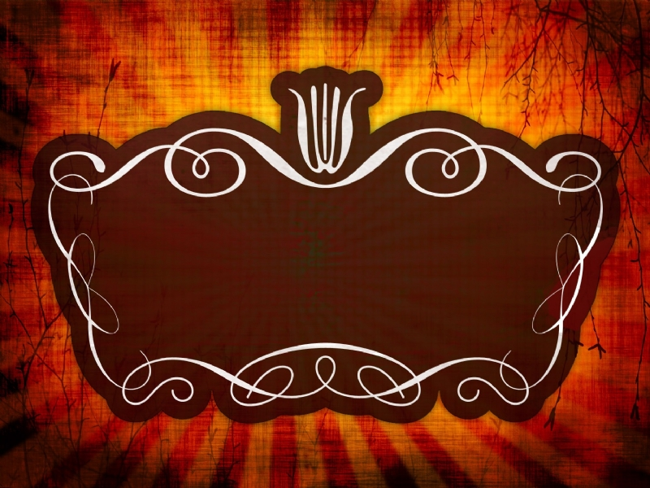
BLESSED ASSURANCE
1st John 5: 1-13

Slide 2

BLESSED ASSURANCE
1st John 5: 1-13
Intro :
- John’s gospel was written to encourage people to believe in Christ for eternal life
John’s first epistle was written to believers that we “may know
that we have eternal life”
(The word “know” or “known” is used 38 times in only 5 chapters)
Assurance of salvation is something that God wants us to have

Slide 3

what is salvation
?
It means every sin is forgiven and buried in the grave of God’s forgetfulness
(2) It means that the Holy Spirit comes to live within us
(3) It means that when we die (or Jesus comes again) we have the blessed assurance
of a home in Heaven

Slide 4

?
“Question Mark Christians”
When we continually question our own salvation, we are going through our
Christian walk with our heads bent over like a question mark.
Assurance allows you to stand erect, confident that you have a home in Heaven,
and the deed has been purchased by the blood of Jesus

Slide 5

WE ARE PURCHESHED BY HIS BLOOD

Slide 6
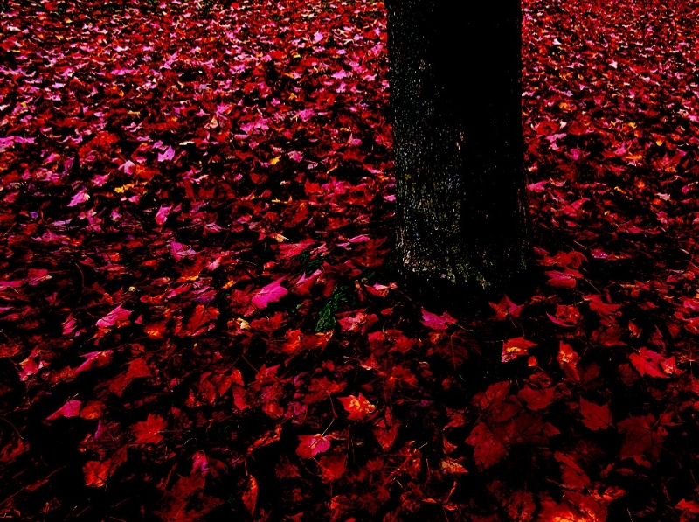
“These things I have written to you who believe in the name of
the Son of God,that you may know that you have eternal life,
and that you may continue to believe in the name of the Son of God.”
(I John 5:13)

Slide 7

JOHN 3: 1 TO 8

Slide 8
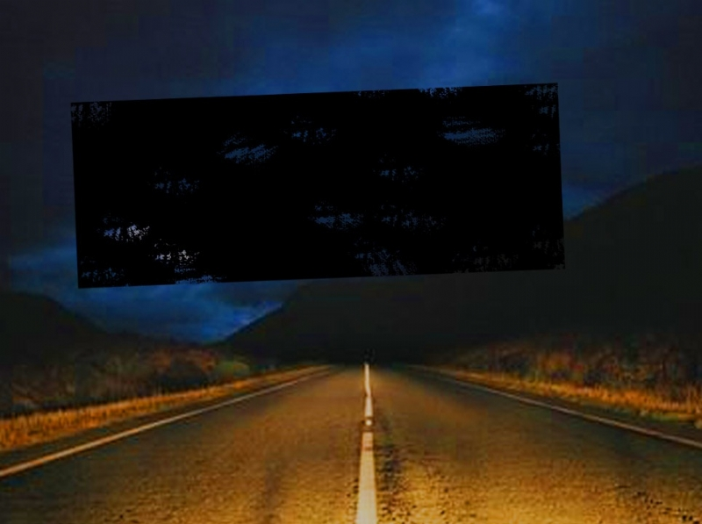
Can a Christian doubt ........... salvation?
Trying to live our Christian life constantly
in doubt is like trying
to drive a car with the brakes on –

Slide 9
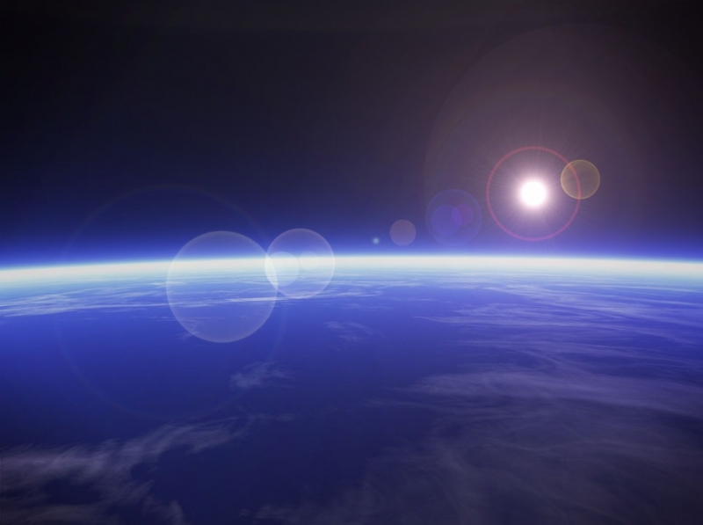
The Bible says that Abraham was justified by his ‘faith’
“For by grace you have been saved through faith,
and that not of yourselves;
It is the gift of God, not of works,
lest anyone should boast.”
Ephesians 2:8, 9

Slide 10

ASSURANCE OF SALVATION
A Christian cannot be EFFECTIVE as a Christian if they don’t have the
ASSURANCE of their salvation.

Slide 11
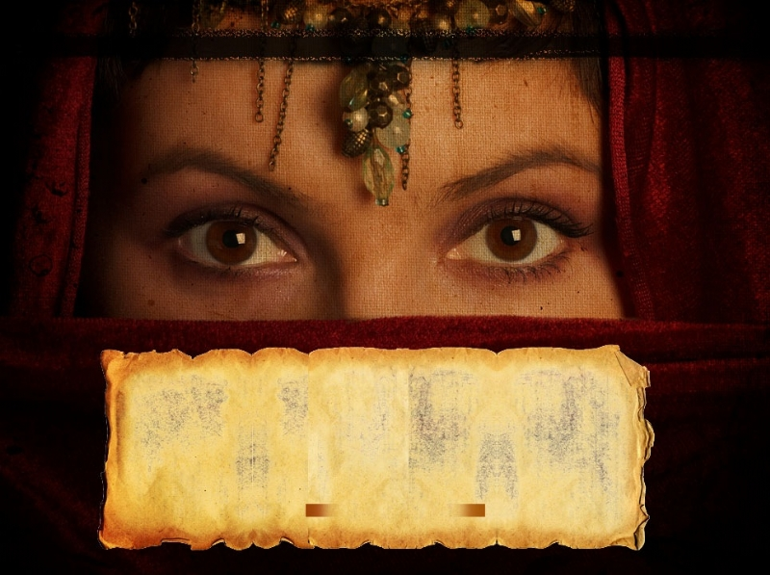
ARE YOU PREPARED / READY
JESUS IS YOUR KING
HE IS COMMING AGAIN
TO TAKE HIS BRIDE ( you) WITH HIM

Slide 12
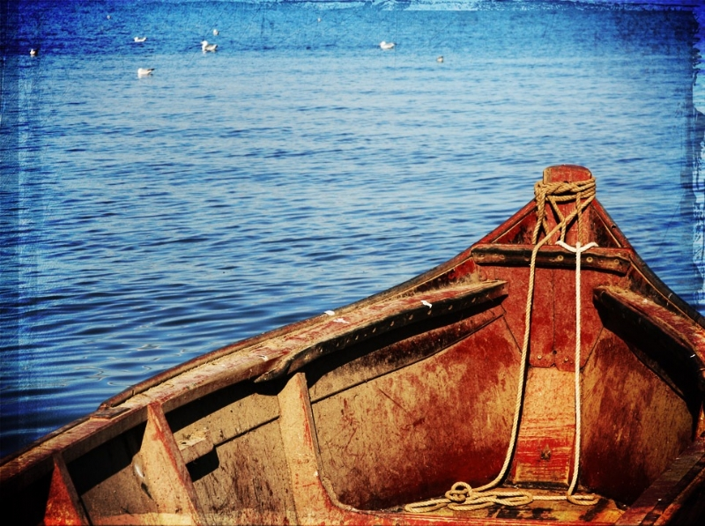
OBEDIENCE
The heart of being a Christian is living in OBEDIENCE to God and His Word.
DISOBIDIENCE would be like passing your driver’s test, getting your license …
then ignoring all the rules of the road
… you’re headed for trouble …

Slide 13
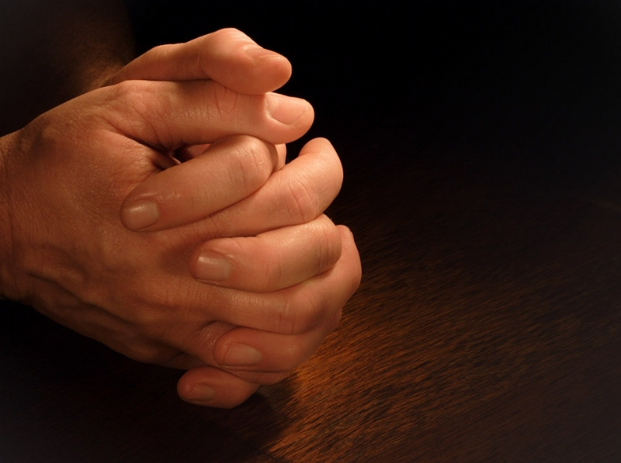
please
PRAY....

